Slide 1
Co-Responder Team
A Collaborative Approach to Policing and Mental Health Support

Slide 2
Introduction
Cleveland State University is proud to be the first university in the state of Ohio to receive a grant for a Co-Responder program.
This program is very important, and it shows a proactive approach to mental health crises, ensuring that individuals in distress receive appropriate support from both mental health professionals and law enforcement. This collaboration not only addresses immediate needs but also aims to prevent escalation and promote long-term well-being by connecting individuals with the right resources.

Slide 3
What is a Co-Responder?
A Co-Responder is a mental health professional paired alongside a police officer to respond to individuals who may be having a mental health crisis, mental illness, or may be experiencing mental health distress.

Slide 4
What is a Co-Responder Team?
The Co-Responder Team is composed of the Co-Responder and a Crisis Intervention Training (CIT) trained officer
The Co-Responder Team will work with students, staff/faculty, and non-affiliated individuals to improve their quality of life, reduce their exposure to the criminal justice system, lessen the frequency of negative contacts with law enforcement, and refer them to appropriate Cleveland State University or community services/resources.

Slide 5
CIT/ Co-Responder Framework
CIT provides training on understanding mental illness, de-escalation techniques, crisis intervention skills and collaboration with mental health professionals
The goals of the framework are:
Safety for individuals and officers
Enhanced ability to recognize mental health distress
Reduction in mental health stigma
Reduction in arrests
Promote better outcomes for individuals in distress

Slide 6
When to Request the Co-Responder Team?
These decisions will ultimately be made by the (OIC)Officer in Charge. However, some common situations may include:
Mental health or substance use related distress
Assessment and safety planning around suicidality
Emotional support needed following distressing event/crime
Extra support on scene
Panic attacks or overwhelming emotions
Urgent connection to food, housing, or treatment resources
Voluntary transport for mental health hospitalization

Slide 7
What will the Co-Responder Team Do?
Be visible and make connections on campus with students, staff and faculty
Provide assessment, de-escalation, resources and other support on scene when needed or requested.
With the individual’s consent the Co-Responder will check in via call or email and follow-up to further support connection to ongoing resources

Slide 8
Intended Program Impact
Appropriately match the mental health and law enforcement response to the needs of the distressed individual.
Improve quality of life and long-term well-being by reducing exposure to the criminal justice system and connecting individuals with appropriate services.
Equip first responders with the tools they need to handle mental health situations effectively, supporting safe and compassionate interactions.

Slide 9
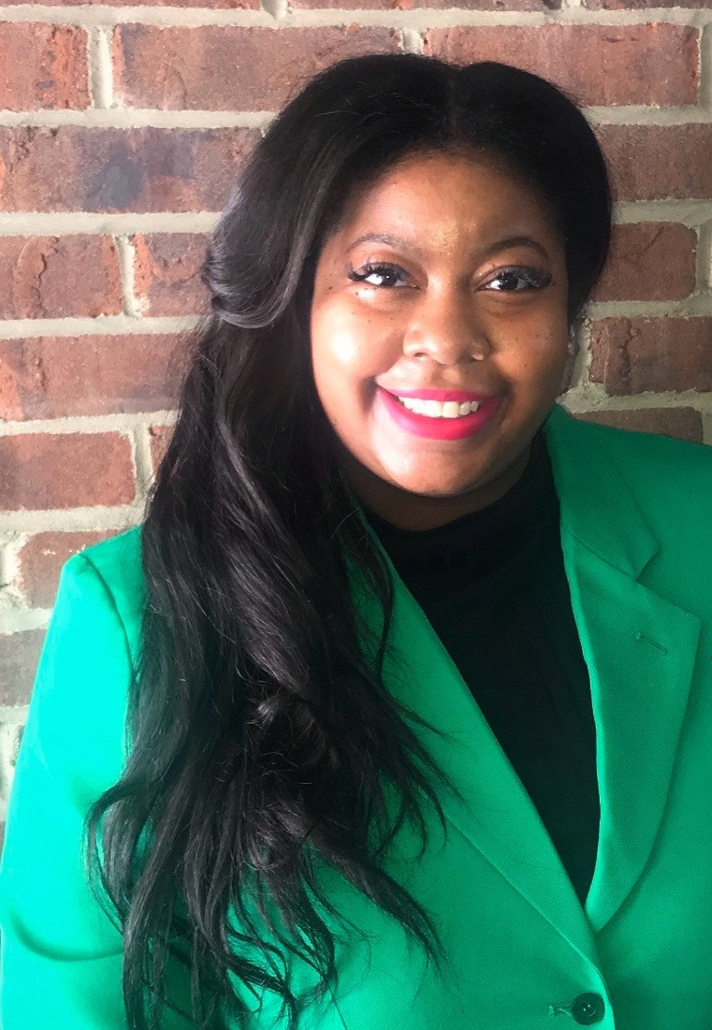
Meet CSU’s New Co-Responder
Essence Bates, BA, MSW, SWA

