Slide 1
Accessible PDF’s
Jeffrey Dell
Assistant Director AT and Access
Bill Milhoan
Alternative Media Specialist

Slide 2
What We Will Be Discussing
PDFs are not easy and sure not fun
Benefits of accessible PDFs
What is in an accessible PDF
Basic checks for PDF accessibility
Toptal Accessibility Portal
How to create accessible PDFs
Demonstrating PDF accessibility in Adobe Acrobat

Slide 3
PDFs are Not Easy and Sure Not Fun
If you have an accessible Word or PPT, it is not necessary to convert to PDF
Image PDF documents can be quick and easy, but creating accessible versions is time consuming and difficult
Find accessible versions where possible
Don’t use PDF’s if there is a choice

Slide 4
Alternatives to PDFs
It is far easier to remediate documents using programs like Word or PowerPoint than to create an Accessible PDF
May want to recognize the text and save and edit in Word
You can Save As in Office applications as an accessible PDF if document contains accessible elements.
Can copy over the article content into a Blackboard page to create an accessible version.
Can sometimes find more accessible HTML versions of articles in Research Databases
Accessibility of information like Math equations are far more accessible in Word or PowerPoint than PDF

Slide 5
Benefits of Accessible PDFs
The documents can be scaled to match size of display and text can be reflowed to make reading easier for the user
Easier to extract text and images to copy into notes and other documents
Images are correctly identified for the application displaying the PDF that makes it easier to resize the images and present accurate information to the user
PDFs are a very popular format that can be displayed on many devices and provide the same view as the print version

Slide 6
PDF Accessibility Attributes
Underlying text matches the visible document
Has proper heading structure
Images are identified and have alt tags
Document can be resized to 200% or 400% without the document being too distorted or pixelated
Special characters, symbols, and languages are properly identified and are not represented as images

Slide 7
Testing for PDF Accessibility

Slide 8
Tools for Checking Accessibility
Adobe Acrobat Prepare for accessibility tool > Check for Accessibility
Blackboard Ally Accessibility Check
Manually Checking

Slide 9
Checking for Accurate Text
Copy and paste into text editing program like Word or Notepad
Use Reflow to show the underlying text
Save the file as Plain Text and compare
Use Read Out Loud from the View menu in Acrobat
Fix by running Find OCR Suspects
If the document is really bad, may need to edit and save outside of Acrobat

Slide 10
Document Text and Images can be resized
Check by using Acrobat to Zoom in to the image or enlarge it to 200% and 400%
Reflow under View > Zoom can be a good tool for resizing
If grainy and distorted:
rescan the image from which it came at a higher resolution
render a new graphic from the original document using a higher resolution
recreate the graphic using scalable vector graphics.

Slide 11
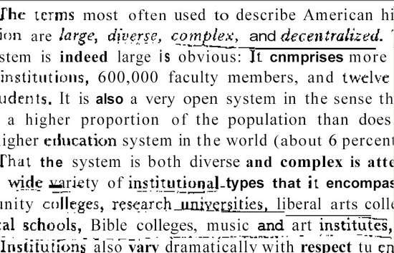
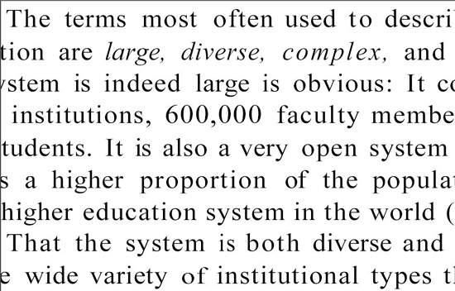
Good vs. Bad Image
Bad Scan at 400%
Good Scan at 400%

Slide 12
Alt Tags Contain Relevant Information
To Check for Alt Tags:
Hold your mouse over the graphic
What should an Alt Tag say?
Describes all important info derived from the graphic with text
Needs to be described more thoroughly when is not explained in text of document

Slide 13
Toptal Accessibility Portal
TAP Login Page
https://app.accessibility.toptal.tech/auth/signin

Slide 14
What Does Toptal (TAP) Do?
Upload inaccessible PDF documents
Download more accessible document
Uses Adobe Acrobat OCR and Auto Tag API’s
Uses Ai engine from Amazon to generate alt text for images
Has page size limit of 100 pages per file before it breaks them up
May take until next day to finish processing a document
Does not add form fields to PDF’s

Slide 15
Some Identified Difficulties
Results not perfect and likely to require some additional remediation
Have seen it skip some pages in PDF documents
May take a long time to remediate larger files
Does not always split large files properly and may fail to process
Has failed to upload some files for reasons unknown
Some files that fail to upload a name change will make it work
Not a silver bullet to slay the PDF dragon
Garbage document in and garbage document out

Slide 16
What Is It Good For:
Not absolutely nothing
Can process batches of documents
Applies OCR, tag structure, and alt text descriptions faster than a person will
Helps with improving PDF accessibility and making better documents
Doing a manual check faster than tagging the entire document manually

Slide 17
Creating Accessible PDFs

Slide 18
Things That Make it Easier
Best to create the PDF from a Word document or other office document if available. Easier to add accessible elements before saving than to add them in Adobe Acrobat
Scan in higher quality. Preferably 400 dpi and no smaller than 300 dpi.
Get good quality scans while limiting skewing and shading.
Get copies of documents that are clean and do not contain generation loss or writing on top of the text
Use a good scanner for digitizing like the Xerox scanners in department offices or the Kick scanners in the Library
Get good copies of articles from the Research Databases where available. Can even link to those articles directly.

Slide 19
Creating Accessible Documents in Adobe Acrobat
Documents need to have Optical Character Recognition (OCR) run on them to have text
Tagging documents is marking up the reading order and identifying items like headings, figures and tables aside from the text
Acrobat is not the easiest program to use
Will need to use Acrobat to tweak TAP documents

Slide 20
What We Are Demonstrating
Edit document properties to include language and title
Run Optical Character Recognition on the document
Find and correct suspect OCR issues
Creating the Reading order for the document (Headings, text, figures, lists and tables)
Alt Text for the Images
Accessibility Check Wizard

Slide 21
Resources for Splitting and Merging PDF’s
May need to break up large documents to process in TAP
Can split by number of pages or bookmarks
Splitting a PDF into Multiple Documents through Adobe Learn site
https://www.adobe.com/learn/acrobat/web/split-pdf-file?ntd=1
Splitting a File into multiple Documents YouTube Video
https://www.youtube.com/watch?v=lLxAorv_k0I
How to Extract Pages from PDF in Adobe Acrobat from Adobe Learn site
https://www.adobe.com/learn/acrobat/web/extract-pages-from-pdf?ntd=1
Extracting Pages from A PDF in Adobe Acrobat YouTube Video
https://www.youtube.com/watch?v=UydQ0vQ3_8Y
Combining Pages in Adobe Acrobat Adobe Help site
https://helpx.adobe.com/acrobat/desktop/edit-documents/combine-files/combine-files.html
Combine Files in Adobe Acrobat YouTube Video
https://www.youtube.com/watch?v=KTa-kvG97V0

Slide 22
PDF Accessibility Resources and Videos
The accessibility reports always say manual check in TAP and Adobe Accessibility Checks for color contrast, reading order, and verifying alt text accuracy
Create and Verify PDF Accessibility - Adobe Help site
https://helpx.adobe.com/acrobat/using/create-verify-pdf-accessibility.html
Remediate a PDF for accessibility using Adobe’s Accessibility Checker - YouTube Video
https://www.youtube.com/watch?v=7ms9iAE1Q9I
Using Reading Order Tool - Adobe Help
https://helpx.adobe.com/acrobat/using/touch-reading-order-tool-pdfs.html
YouTube Video for PDF Reading Order Tools
https://www.youtube.com/watch?v=7848WpKuAi0
Fix PDF Reading Order Tool on YouTube
https://www.youtube.com/watch?v=bAi8FFbCsF8

Slide 23
PDF Accessibility Resources and Videos (Cont’d)
Adding Alt Text to an Image in Adobe Acrobat YouTube Video Short
https://www.youtube.com/watch?v=htgPDe7dWp8
Adding Alt Text to Images in Adobe Acrobat - Accessibility Guy YouTube
https://www.youtube.com/watch?v=T5JYzSxCF_8
Fixing Table sin Adobe Acrobat – YouTube
https://www.youtube.com/watch?v=GtRnVNLqGq4
Adobe Acrobat Table Editor - W3C
https://www.w3.org/WAI/WCAG22/Techniques/pdf/PDF20
Edit a Table in Adobe Acrobat - Accessibility Guy
https://www.youtube.com/watch?v=csE6h2rXF-E

Slide 24
Writing Descriptions for Alt Tags
Keep it brief: Aim for roughly 125 to 150 characters or a single clear sentence.
Skip "image of": Screen readers already announce that an element is an image, so starting with "picture of" or "photo of" wastes time.
Focus on purpose: Describe what the image communicates in context, rather than listing every minor visual detail.
Include text in images: If an image contains words (like a flyer or banner), write those exact words out in the alt text.
End with a period: A closing period ensures the screen reader pauses naturally after reading the description.
Points taken from section 508.gov
Writing Alt Text for Stem content

