Slide 1
Recording Handwritten Content For Online Delivery
John Hubbard and Chris Rennison
Center for Instructional Technology and Distance Learning

Slide 2
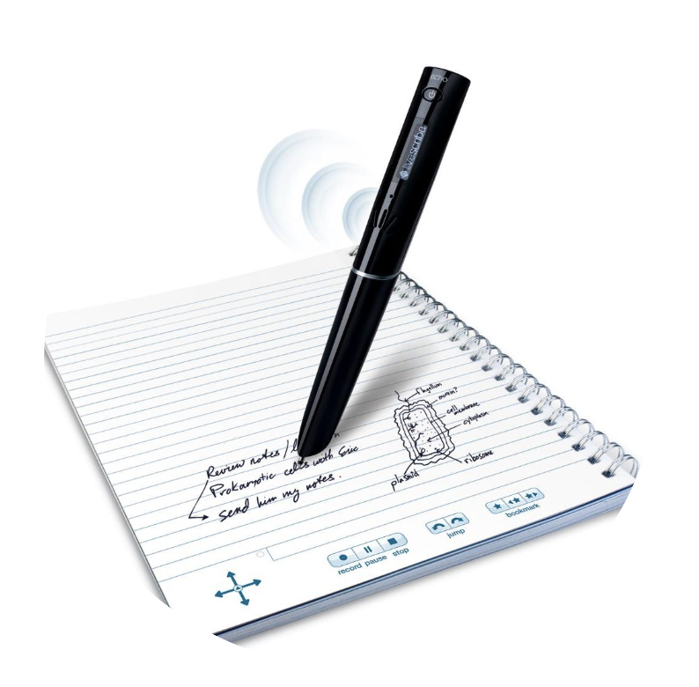
Livescribe Pens
Echo Smart Pen
https://www.livescribe.com/site/livescribe-2/echo/
Records ink on paper with audio
Downloads recordings from pen to desktop application
Desktop application creates a narrated PDF
Narrated PDF can be dropped into Livescribe's online player at livescribe.com/player

Slide 3
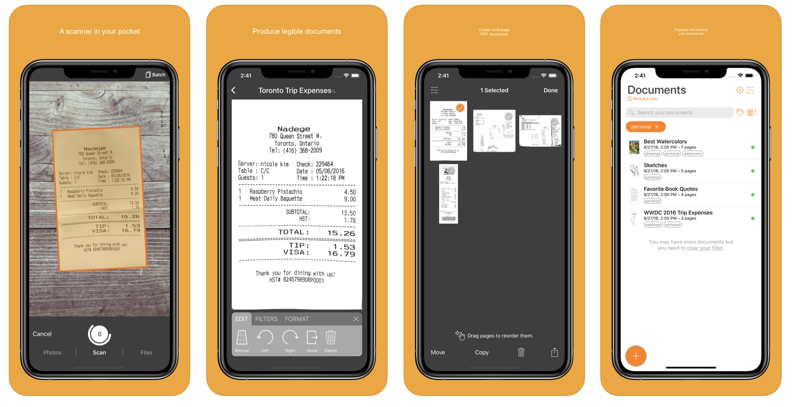
Your Smartphone
Apps for converting photos and handwritting to documents
Writing on paper
Take a photo of it (either with camera app or scanning app)
Some tools for editing
Save and send
Genius Scan
Video uploads to Panopto
Log-in
Panopto Content
Create>Upload Media

Slide 4
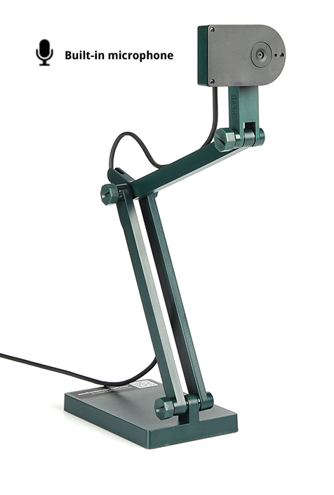
Document Cameras
Document Cameras are basically a camera pointed toward a work surface. If you have a Web Camera, you can point it at a work surface.
Some Web Cameras have tripod mounts
Some cameras and services have "mirroring" - reverses image.
Turn off mirroring
Hold a document up to a Web Camera, it's a Document Camera

Slide 5
Wacom Tablets
Basically an enlarged trackpad like those found on laptops
Many versions – medium or larger for most users
Challenge: You can't see what your writing without looking at the monitor

Slide 6
iPad
Integrated in Zoom
Stand-alone touch screen device
Apple Pencil – enhanced features

Slide 7
Touch-Enabled Devices
Touch screen monitor/display
Whiteboard software, PowerPoint (Draw) OneNote (Draw), etc.
Android Tablet
Connect to computer
Duet Display or similar
Finger or Capacitive Pen

Slide 8
Delivering Handwritten Content Live
Pick your delivery platform
Zoom, Collaborate, Teams, Panopto (streaming only)
Document Camera/Web Camera
Wacom Tablet
Touch Screen
Tablet connected to PC
Whiteboard App, PowerPoint (draw), OneNote (Draw), etc.

Slide 9
Information and Contacts
Circulating equipment to faculty – full semester loan
Webpage: https://www.csuohio.edu/citdl/equipment-circulation
Contact: Valerie Isom – v.isom@csuohio.edu
Other contacts
Remote Support Email: instructionaltech@csuohio.edu
Zoom Meeting: https://csuohio.zoom.us/j/3083308350
Our links are available here and in the archive at https://www.csuohio.edu/keep-teaching

