Slide 1
RSO Treasurer Training
Presenter: Dan Lenhart, Marketing & Web Specialist
Student Center 319 Center for Campus Engagement d.lenhart@csuohio.edu

Slide 2
By the end of this training, Treasurers should know…
Timelines of when to submit requests
Fiscal policies and where to find them
University purchasing policies
Travel policies
Fundraising
How to create an allocation and expenditure request
How to deposit funds

Slide 3
Main Contact for all financial questions
Contact the Center for Campus Engagement for all financial questions at studentorgfinance@csuohio.edu

Slide 4
Explore your organizations Finance tool (Only Treasurers can use the Finance tool)
Accounts
Agency Account
Balance rolls over between years
Number avail to officers in Details tab
Allocating Body Funding Account
Funds to be used for specific purpose
Unused funds are swept

Slide 5
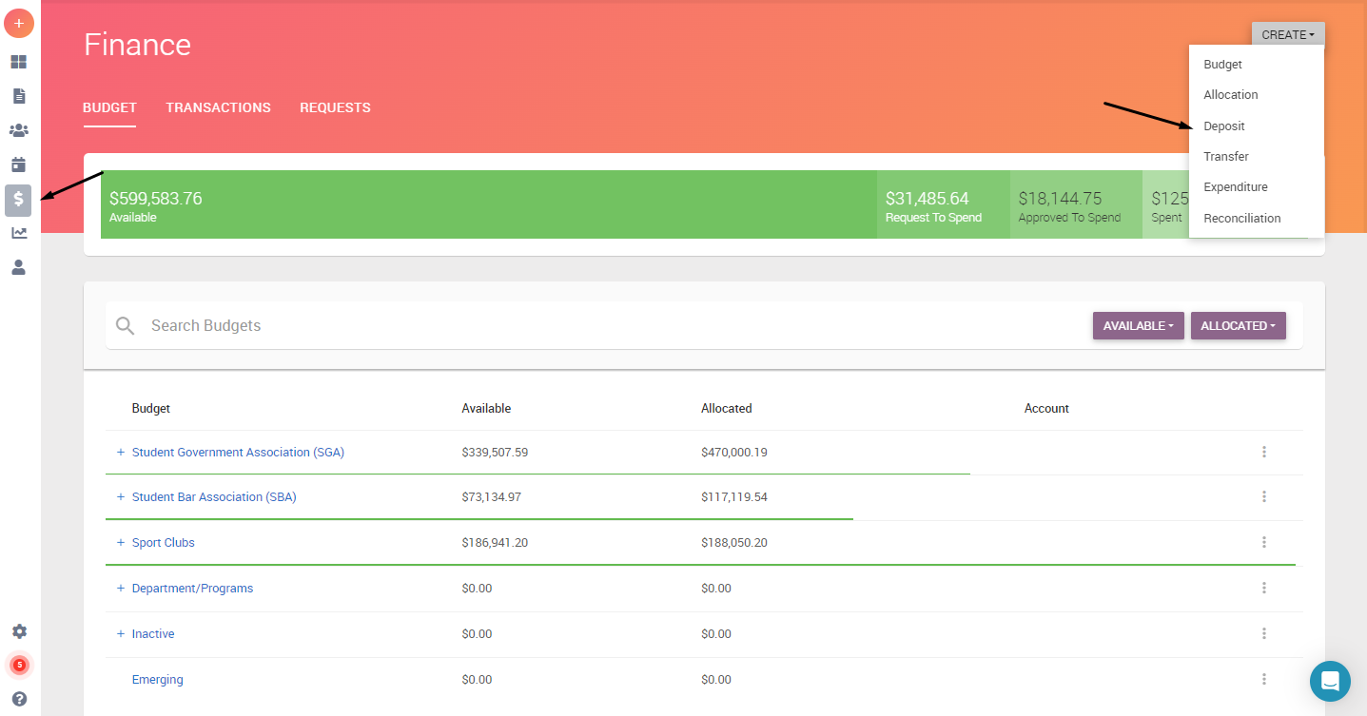
VikesConnect Finance Tool
Not connected to CSU accounting system
Used as a way to track all expenses and deposits
Reconciliations are done by budget officer
Deposits are part of finance tool.

Slide 6
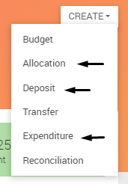
Finance Forms for Treasurers
Treasurers will only use three forms in the Finance Tool
Allocation: To be used when requesting money from a funding body
Deposit: Use when depositing money into agency account
Expenditure: Use when purchasing or reimbursing

Slide 7
Financial Request Timelines:
Event Requests - Travel : 45 business days prior to departure
Event Requests : 45 business days to 5 business days based on classification type
Payment - Purchase Requests : 45 business days for contractual payments to 30 business days for all other purchase requests.
Reimbursement - Purchase Requests : No later than 10 business days after purchase or return from travel

Slide 8
Explore your organizations Finance tool (Only Treasurers can use the Finance tool)
Allocation Requests
Complete all required fields
Can combine multiple needs into one request
Documentation must be submitted to support your request
Application deadlines
SGA will release their schedule. Found on the SGA VikesConnect page.
SBA open all year until the funds run out.
SCC have a separate allocating process (do not use budget requests)

Slide 9
Explore your organizations Finance tool (Only Treasurers can use the Finance tool)
Expenditure Requests (Payment & Reimbursement)
Using Agency Account funds vs Approved Budget funds
Notify your advisor through email every time you submit a purchase request.

Slide 10
Food Policies
Food policies are only for on-campus food consumption.
Less than $300 use any food vendor
$301 to $749, use Viking Food Co. Catering or Rascal House
Above $750, use Viking Food Co. Catering
Any food consumed on campus and costing $300 or more needs to have catering waiver, & proof of insurance for exceptions
Check with business to see if they have received payment in the past from CSU. If not, we will have to set them up as a vendor
If you want to order Rascal House via Magnus Mart, you must allow 7 business days to process.
CSU will not pay in advance. Payment is made once items have been delivered.
If you need to increase any catering orders, check with budget officer first.
We cannot order food from Amazon.

Slide 11
Expenditure Requests (Spending)
For Promotional Items, use one of the three IUC vendors
For online orders, do not place them yourself. Submit request with information and we will make the purchase for you
DO NOT purchase items from Amazon or Apple for your organization. CSU will not reimburse students who purchase from Amazon. CSU has a corporate account.
If you need to make a purchase at a store, remember to request a tax exemption form, CSU will not reimburse state of Ohio sales tax.
Pay close attention to Food policies for on-campus food consumption.
If you need to increase any catering orders, check with budget officer first.
All items ordered will be shipped to CSU, not individual’s homes

Slide 12
Expenditure Requests (Reimbursements)
CSU will not reimburse for state of Ohio sales tax.
CSU will not reimburse for any purchases made on Amazon or Apple websites.
If you need to make a purchase at a store, remember to request a tax exemption form, CSU will not reimburse state of Ohio sales tax.
If purchasing multiple items at a store, you submit only ONE request to reimburse.
If payment was made using credit/debit card, a copy of the card used, showing the name & last four digits on the card, must also be attached. The name on the statement/card must match the person receiving the reimbursement.
Reimbursements which are paid for by funding awards must be submitted within 5 business days after an event and 10 days after travel.

Slide 13
Organization Travel
Submit travel request via the Event tool in VikesConnect at least 45 days in advance of travel.
You must meet with our budget officer after submitting the request.
All travel forms MUST be completed prior to travel.
Emergency contact list MUST be submitted
Do NOT make your own travel arrangements. Our budget officer will do this.
This includes transportation (incl. rental cars), accommodations, conference fees, etc.
Each traveler must keep all receipts for reimbursement
Food receipts must list what was ordered. CSU does not reimburse for alcohol.
All reimbursements are submitted as purchase requests and done so at least 10 business days after travel is complete

Slide 14
Events on Campus
Check CSU calendar on Conference Services website for room availability (link in event request form).
Follow Classification Timelines for all events (found both in RSO manual and event request form)
Use Event Planning Checklist to build event budget & track items
Reserve space for event, even if you do not have funding yet. If you do not receive funding, then cancel reservation.
Any contracts must be submitted at least 45 days in advance of event
Consider additional costs
Set-up fees
Equipment fees
Housekeeping fees
Security fees
Pay attention to cancellation policies
PLAN IN ADVANCE

Slide 15
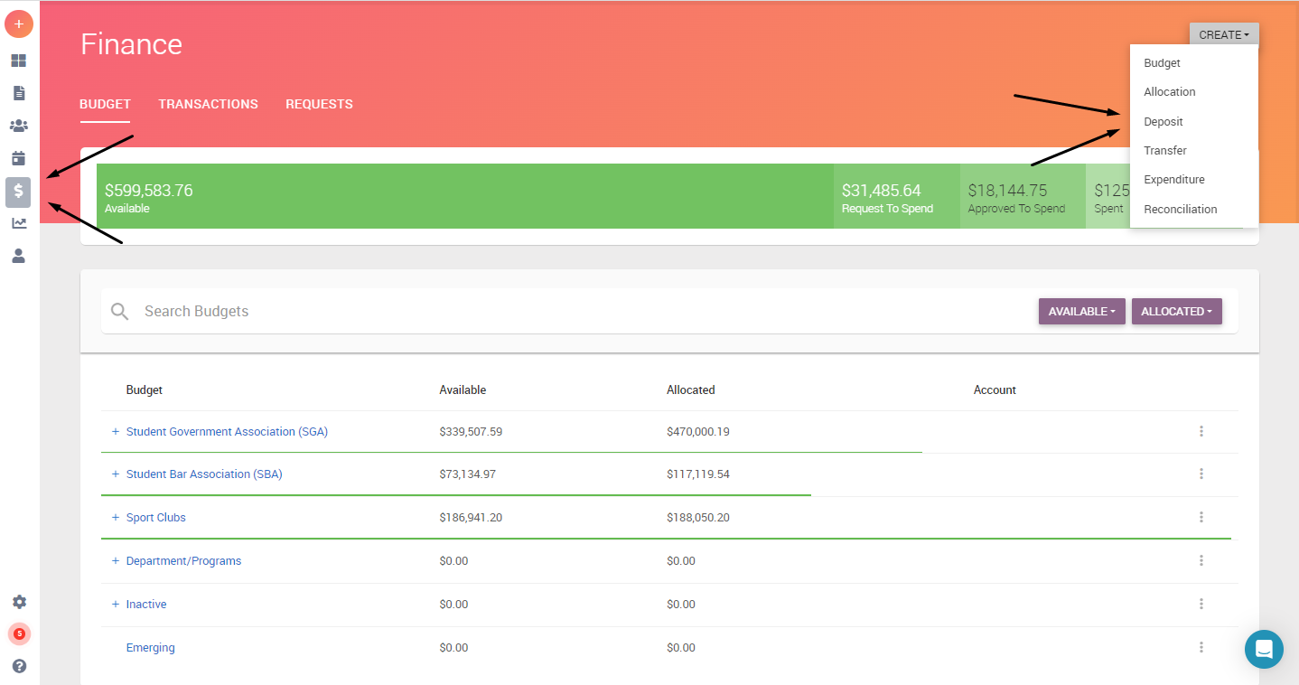
Agency Account Deposits
Create your deposit using the Finance Tool in VikesConnect
Link to Budget Officer’s calendar is in the form: : https://calendly.com/2063661-1
Make an appointment with Budget Officer and bring cash and checks for deposit

Slide 16
ShopNet
ShopNet is used by Cleveland State University departments to allow customers to select and pay for a variety of items on the web using their credit card. Recognized CSU student organizations may submit a request to set up a ShopNet item to accept payments for things such as organization dues, application fees, event entrance fees or other organization items.
For instructions on requesting set-up and details on using, go to: https://www.csuohio.edu/services-for-students/shopnet

Slide 17
Fundraising Activities
Please check with CCE at studentorgs@csuohio.edu before you conduct your fundraiser to ensure you are following policies.
No form of gambling activities (50/50 raffles, games of chance, squares, etc.) are not permitted for RSOs unless they are considered a nonprofit organization by the IRS. CSU is NOT a 501 (c) (3) organization. It is a state institution.
All money raised must be deposited within 24 hours, unless the fundraiser is held on a weekend. In that case, money is deposited that Monday. Complete the deposit request form in VikesConnect.
Organizations must use ShopNet to accept credit/debit card payments.
Bake Sales are permitted. Follow CSU policies regarding food sales on campus.
Sales of items from outside companies is not permitted.

Slide 18
Financial Request Timelines:
Event Requests - Travel : 45 business days prior to departure
Event Requests : 45 business days to 5 business days based on classification type
Payment - Purchase Requests : 45 business days for contractual payments to 30 business days for all other purchase requests.
Reimbursement - Purchase Requests : No later than 10 business days after purchase or return from travel

Slide 19
Reminders
Use your CSU email account to conduct business
CSU does not pay state of Ohio sales tax. Individuals will not be reimbursed for sales tax. Ask for tax exemption form
Do not place orders with an IUC vendor. Only ask for a quote.
Do not place online orders or make travel arrangements.
Money must be deposited within 24 hours after receipt.
No reimbursements for travel will be made without proper paperwork completed prior to travel.
Plan in advance.

Slide 20
Questions
Please email us at studentorgs@csuohio.edu with any questions.

